Slide 1


Neural networks
By:
K . Muthuveeralakshmi.

Slide 2
CONVOLUTION NEURAL NETWORK

Slide 3
What is CNN?
Convolutional neural networks (ConvNets or CNNs) are one of the major types of neural networks used to recognise and classify pictures. detection of objects, identification of faces, etc

Slide 4
CNN layers:
Convoluted layer
Pooling layer
Fully connected

Slide 5
Convolution layer:
Convolutional layer is the first layer in a CNN for feature extraction from input images.
It applies a set of learnable filters or kernels to the input image.

Slide 6
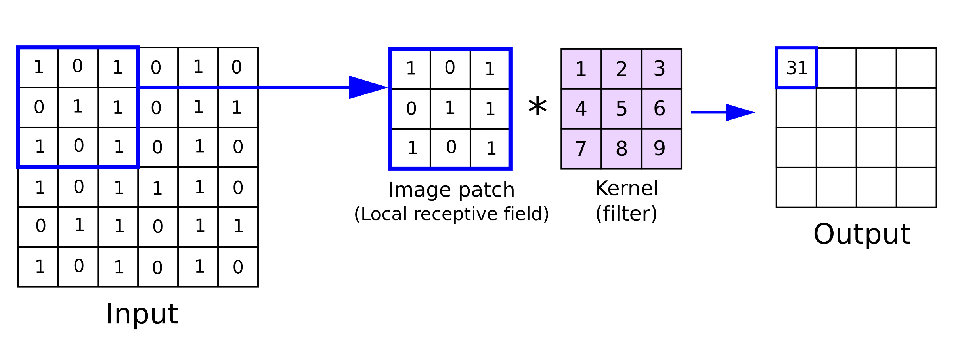
Convolution layer

Slide 7
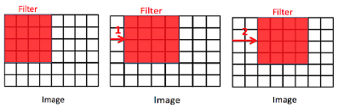
Strides:
Stride is the number of pixels shifts over the input matrix.

Slide 8
Pooling layer:
Pooling layer is a type of layer in a CNN used for downsampling and spatial summarization of feature maps.
Max pooling
Average pooling

Slide 9
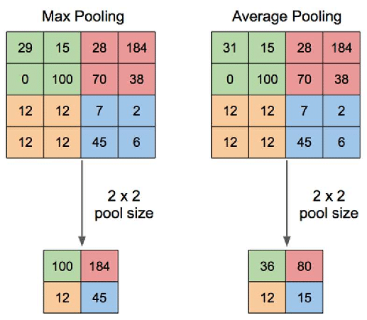
Max pooling: max pooling gives the most prominent feature in a particular patch of the feature map.
Average pooling : average pooling gives the average of features present in a patch.

Slide 10
Fully connected layer:
Neural networks that are fed forward are the Fully Connected Layer. The final several levels of the network are known as Fully Connected levels.
The output from the last pooling or convolutional layer is passed into the fully connected layer, where it is flattened before being applied.

Slide 11
Recurrent neural network

Slide 12
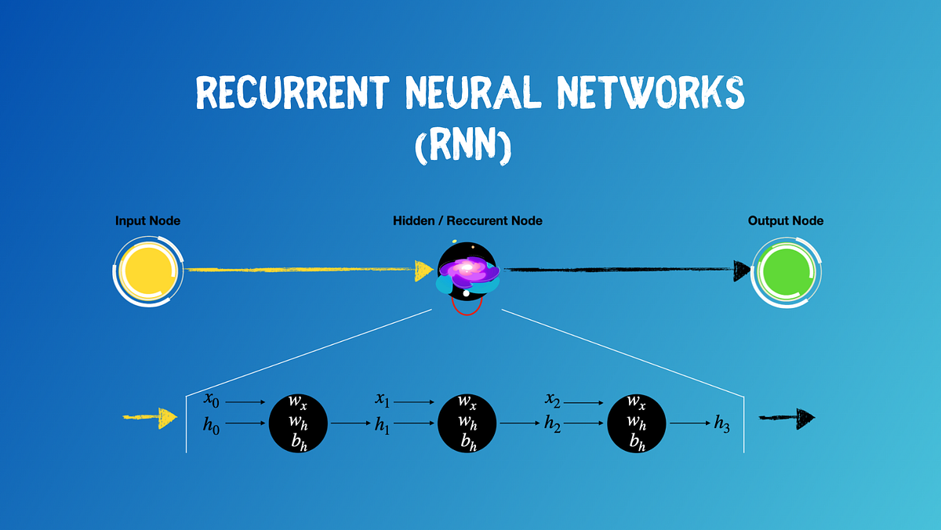
What is RNN?
RNN is mainly used for NLP tasks
Recurrent Neural Network is a generalization of feed-forward neural network that has an internal memory
RNN is recurrent in nature as it performs the same function for every input of data while the output of the current input depends on the past one computation

Slide 13
Types of Recurrent Neural Network:
One-to-One RNN
One-to-Many RNN
Many-to-One RNN
Many-to-Many RNN

Slide 14

one to one RNN:
E.g. classification of image

Slide 15

One to many RNN:
e.g. The image is sent into Image Captioning, which generates a sentence of words.

Slide 16

Many to one RNN:
E.g. Sentiment analysis is one of the examples of this type of network, in which a text is identified as expressing positive or negative feelings.

Slide 17

Many to many RNN:
E.g. Machine Translation, in which the RNN scans any English text and then converts it to French.

Slide 18
Application of RNN:
Prediction problems
Language Modelling and Generating Text
Machine Translation
Speech Recognition

Slide 19
Long short term memory:

Slide 20

What is LSTM?
LSTM is part of RNN
LSTM is capable of learning long term dependencies
LSTM doesn't have large gap problem

Slide 21
Using LSTM:-
Speech recognition
Rhythm learning
Music composition
Hand writing Recognition
End to end translation

Slide 22
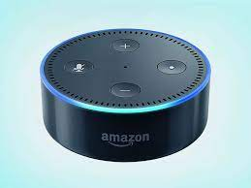
Using LSTM:-
Google:
Speech recognition on smartphones
Smart assistant
Amazon:
Amazon Alexa

Slide 23
Difference between RNN and LSTM:
Recurrent neural network | Long short term memory
Simple, with a single hidden state | More complex, with memory cells and gates
Struggles to capture long-term dependencies effectively | Better at capturing long-term dependencies
No explicit gating mechanism | Uses three gates: input, forget, and output gates
Single-directional information flow | Bi-directional information flow
Suitable for simple sequence tasks | Effective for complex sequence tasks, especially with long-term dependencies

Slide 24
Thank you!!!

